Slide 1
Meeting 7
Tuesday 13/02/2018

Slide 2
Agenda
Park model
Yaw error
Test case
CT curve
BEACon data
LES results
WAsP & Fuga
Next steps

Slide 3
1. Park model
Implemented methods/options
Park 1 or Park 2: correction term
Area Averaging: A_overlap/A_rotor for any point in space
Superposition method: linear, maximum deficit or quadratic
Wake reflection
Section in 3 directions
Horizontal at chosen height
Vertical at downstream position
Vertical at cross-stream position

Slide 4
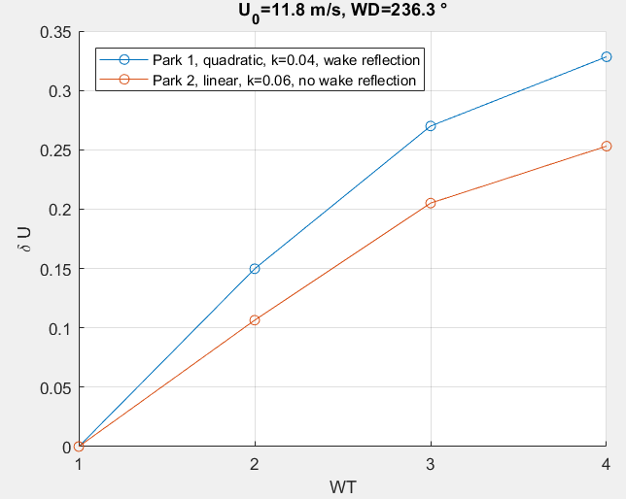
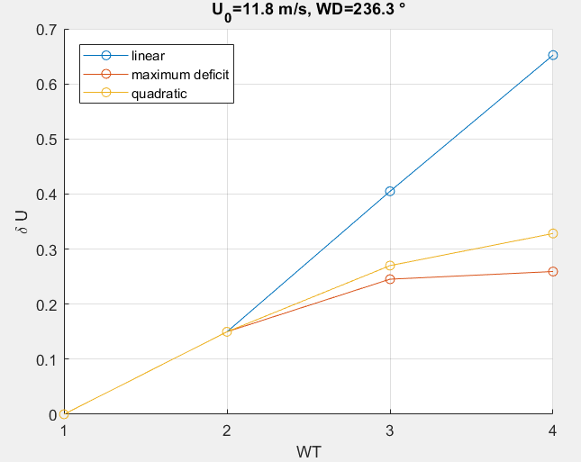
1. Park model
Model used: Park 1, wake reflection, k=0,04

Slide 5
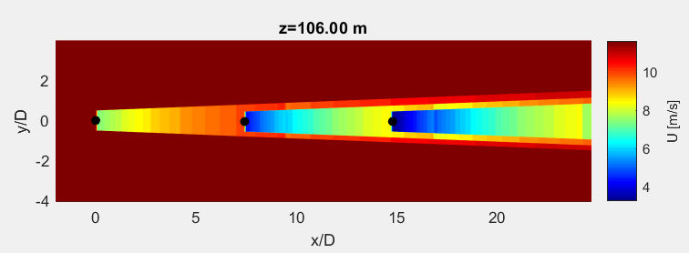
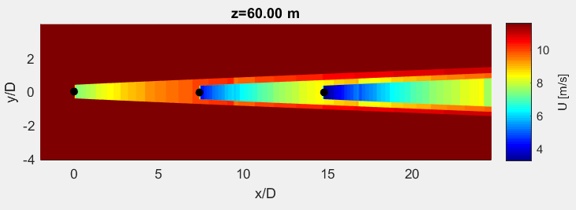
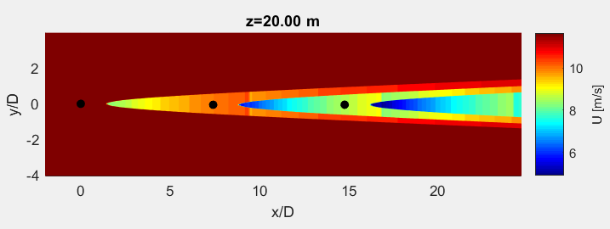
1. Park model: horizontal section
Model used: Park 1, quadratic, wake reflection, k=0,04
Notes:
Park 1
Quadratic
K=0,04
With wake reflection

Slide 6
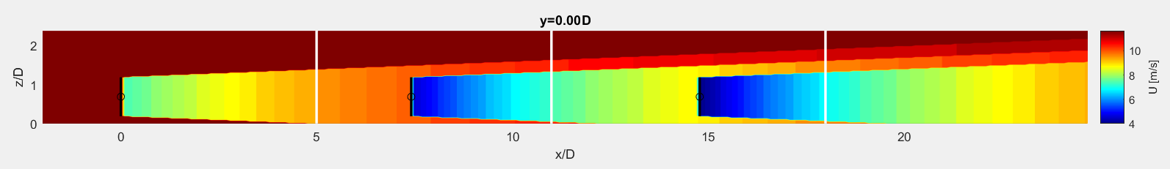
1. Park model: vertical section
Model used: Park 1, quadratic, wake reflection, k=0,04

Slide 7
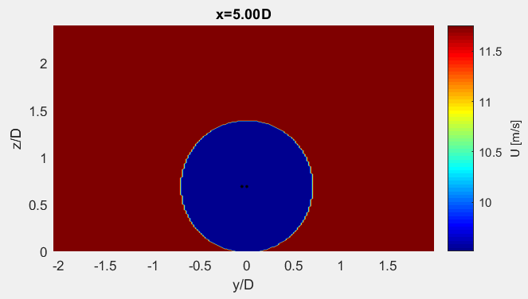
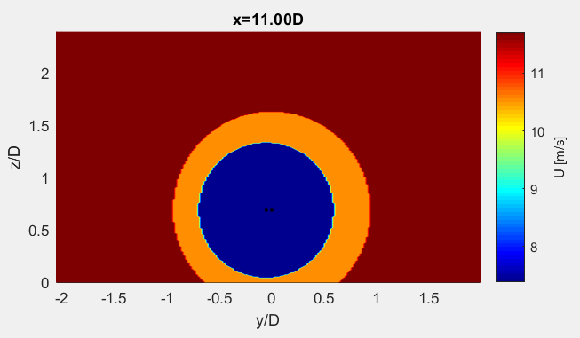
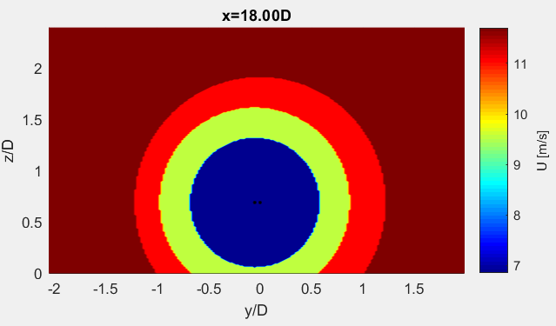
1. Park model: vertical section
Model used: Park 1, quadratic, wake reflection, k=0,04

Slide 8
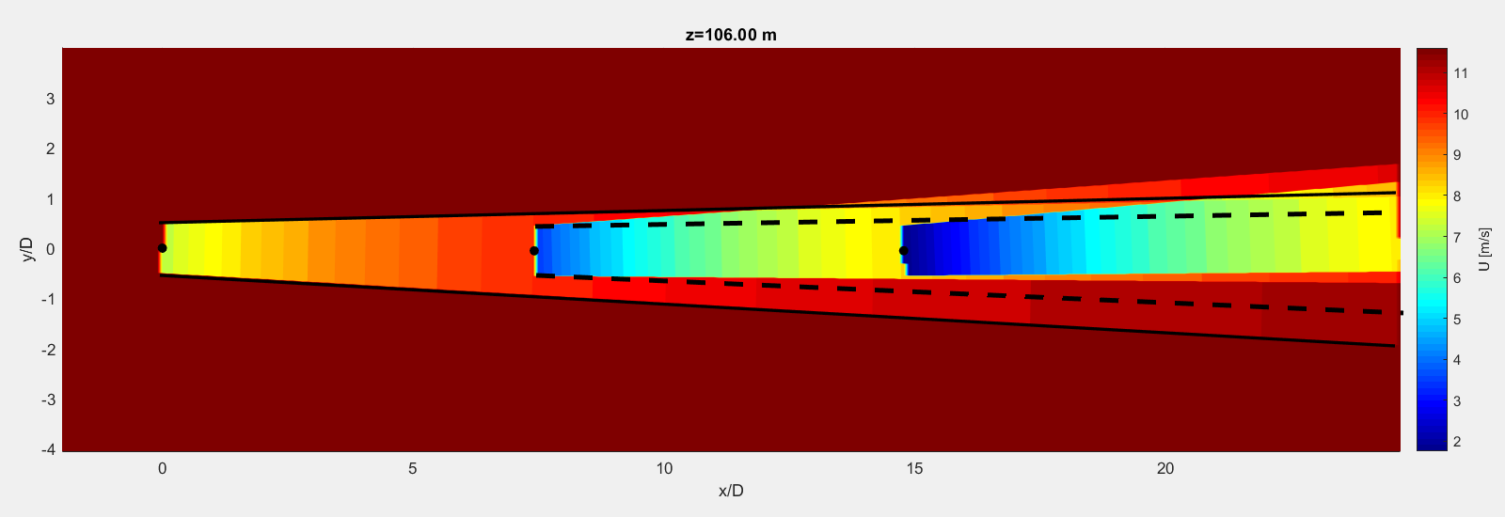
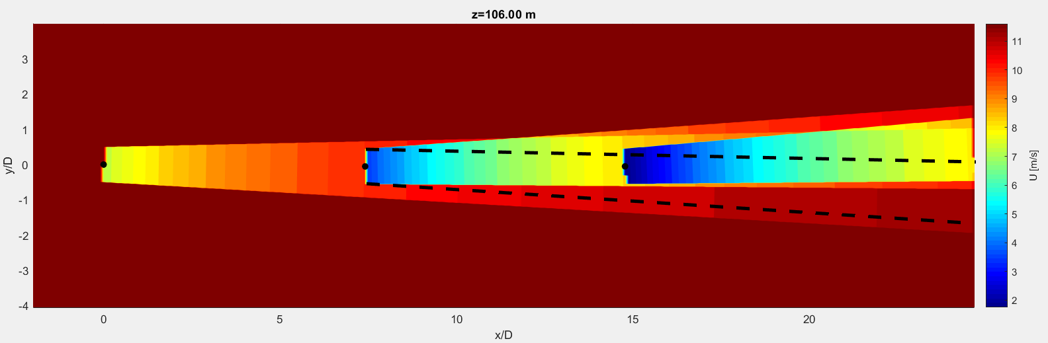
1a. Park model: yaw error
Wake direction does not change,
Only rotor is yawed
Wake direction changes to “opposite direction”

Slide 9
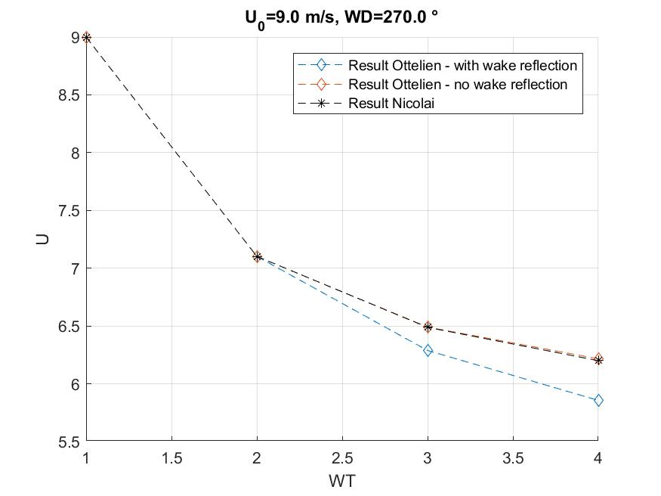
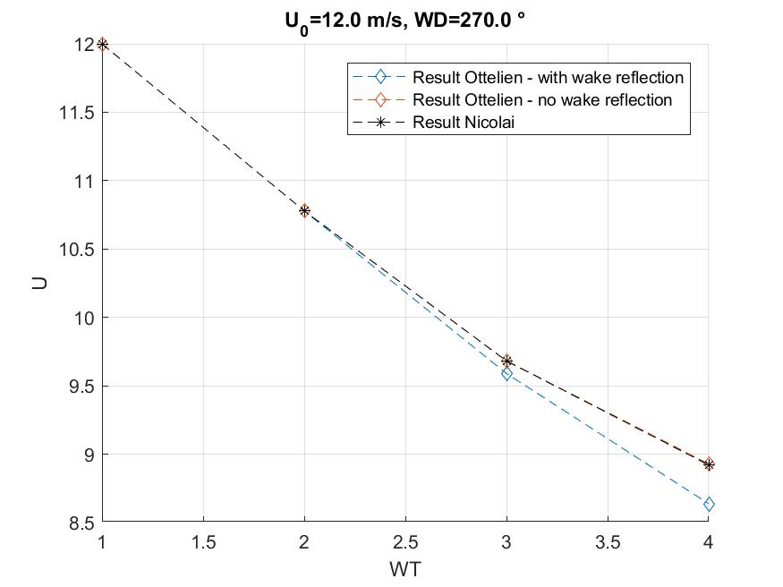
1b. Test Case
Model used: Park 1, quadratic, k=0,04

Slide 10
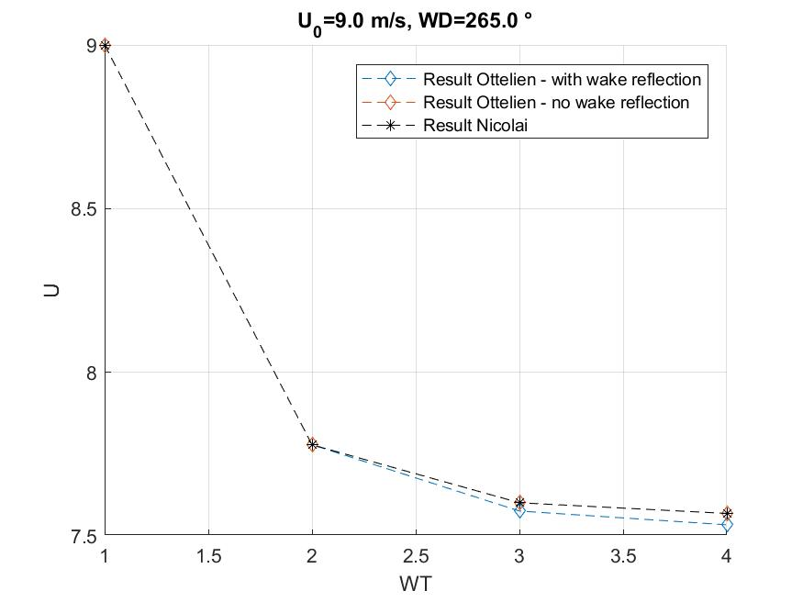
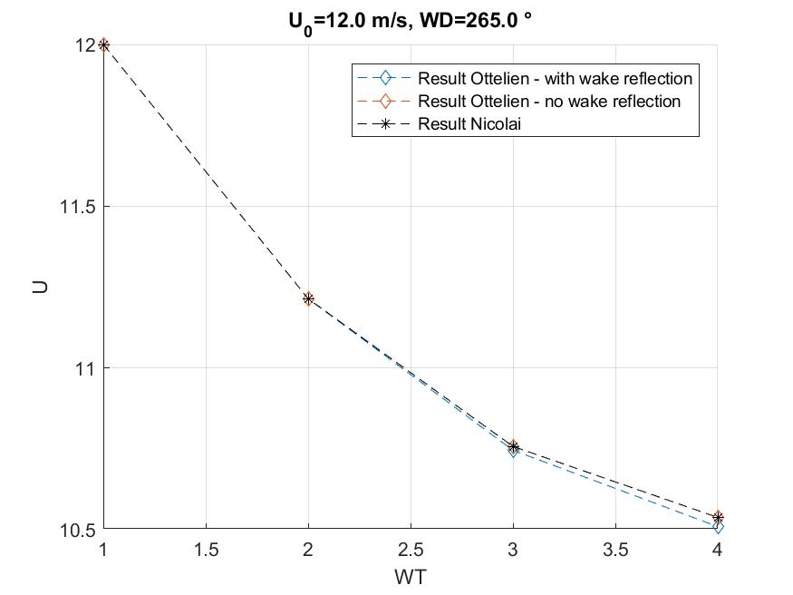
1b. Test Case
Model used: Park 1, quadratic, k=0,04

Slide 11
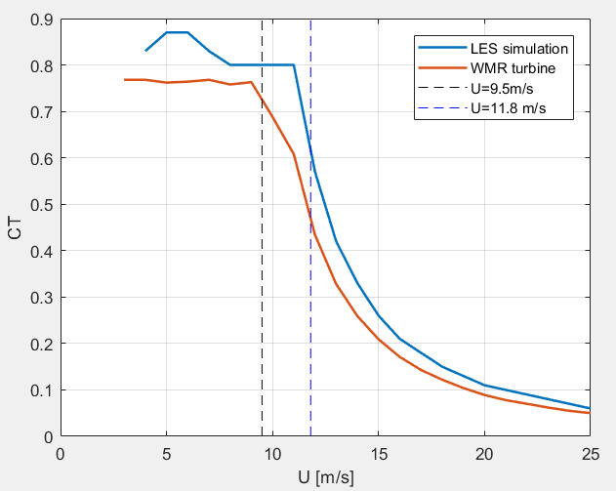
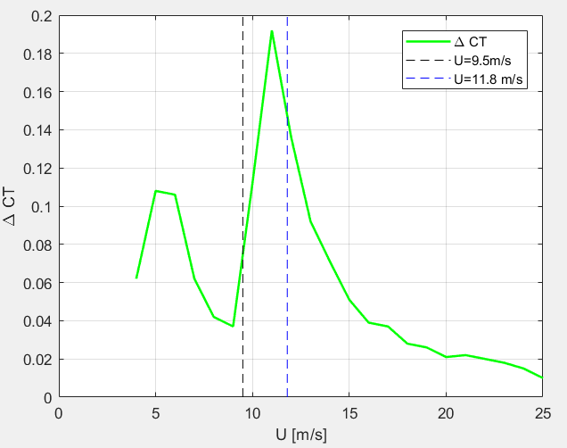
1c. CT curve

Slide 12
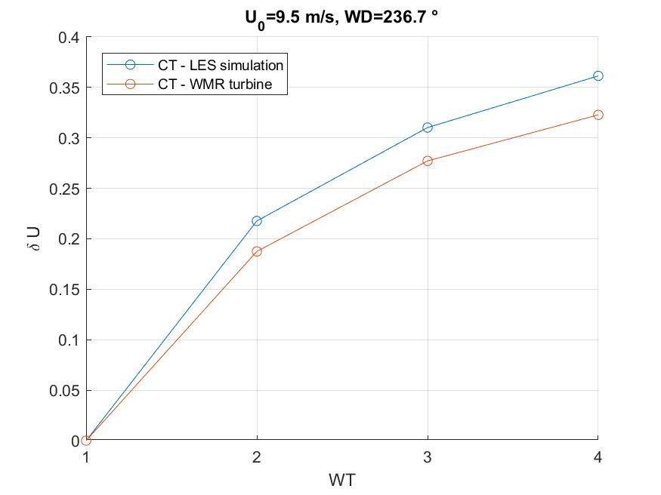
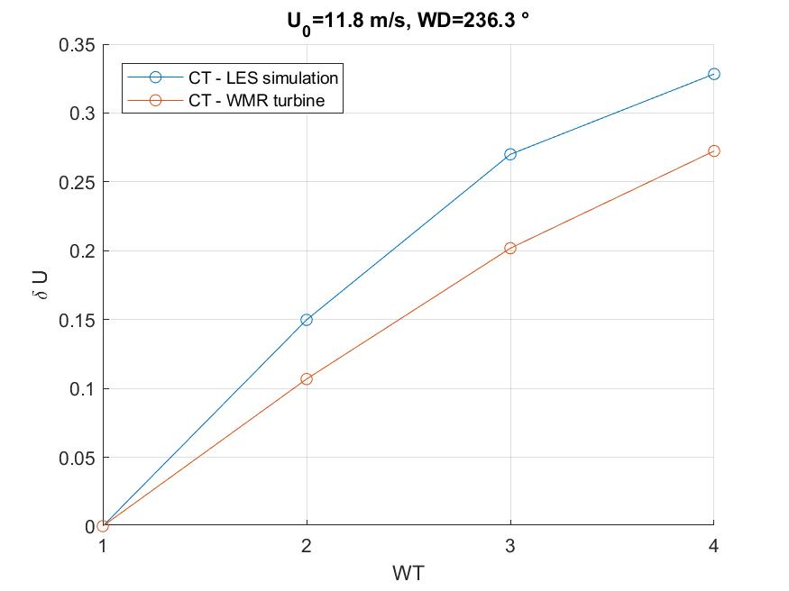
1c. CT curve
Model used: Park 1, quadratic, wake reflection, k=0,04

Slide 13
2. BEACon data
10-min average
Also 10 data available approx. every minute (slabWS)
slabWS_mean is not the mean of this data? How is slabWS_mean calculated?
How are the data interpolated?
Data is given in Cartesian X,Y,Z frame
Measurements are in tilted plane

Slide 14
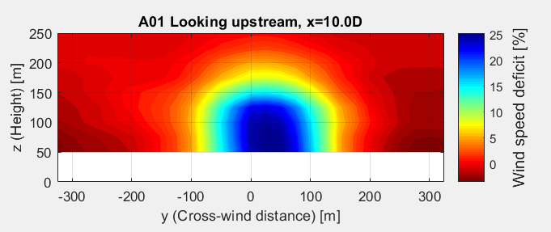
2. BEACon data
At positions a*D downstream, for other position interpolation needed

Slide 15
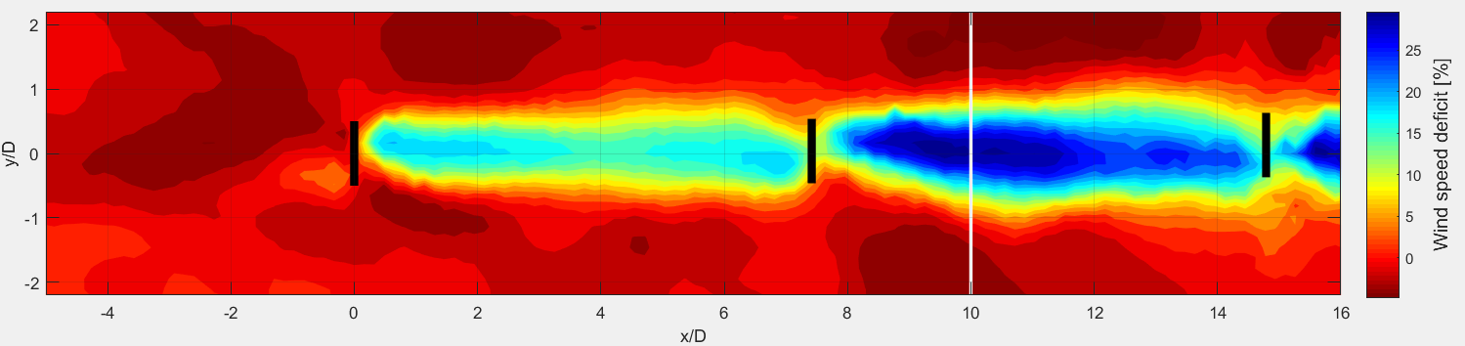
2. BEACon data
Horizontal plane
Exactly at hub height?

Slide 16
3. LES results
Section in 3 directions
Horizontal at hub height
Vertical at downstream position
Vertical through first wind turbine hub
Interpolation possible for tilted planes

Slide 17
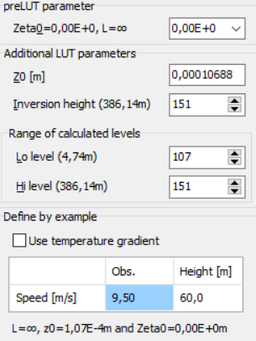
4. WAsP & Fuga
No met. data available Used data from another project, does not change Fuga results
WT file:
CT curve of LES data
CT curve of WMR turbine
Information about stability?
Results:
Wind deficit at each turbine (at rotor center or rotor averaged)
Single wake results
Wind farm results

Slide 18
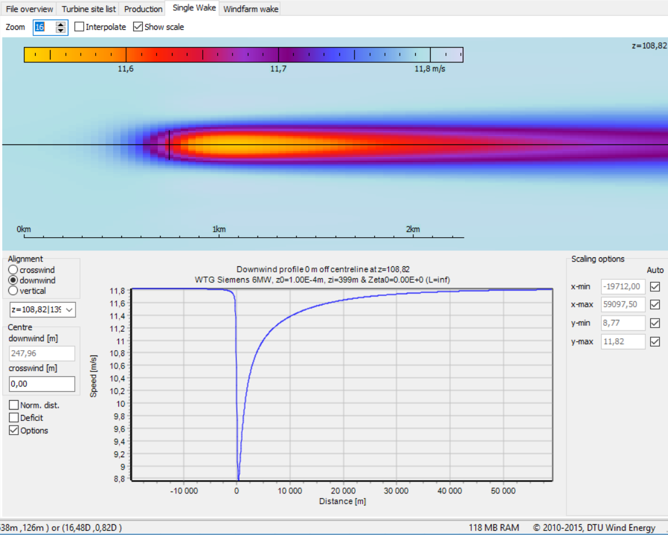
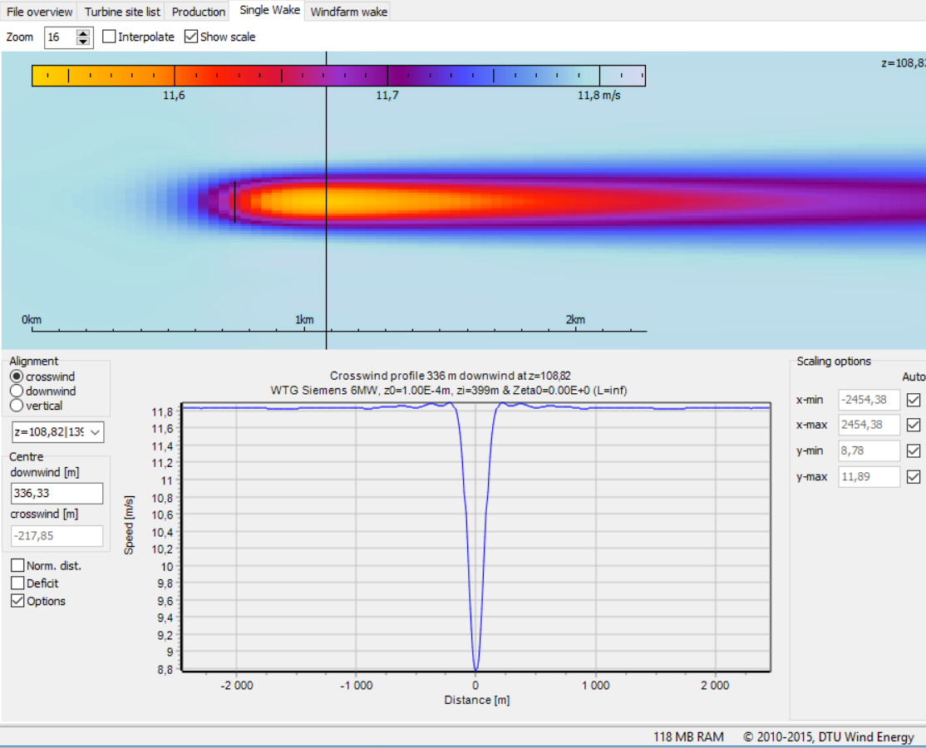
4. Fuga: Single wake results
Crosswind and downwind wind profile can be extracted
Extract complete wind speed/deficit field?

Slide 19
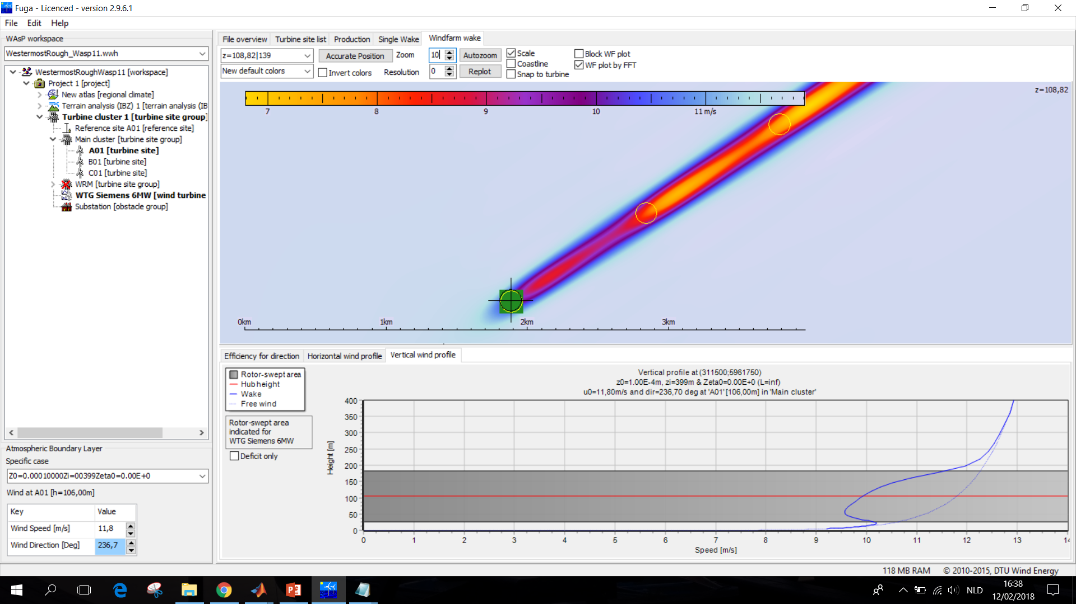
4. Fuga: Wind farm results
Vertical wind profile can be extracted for every location

Slide 20
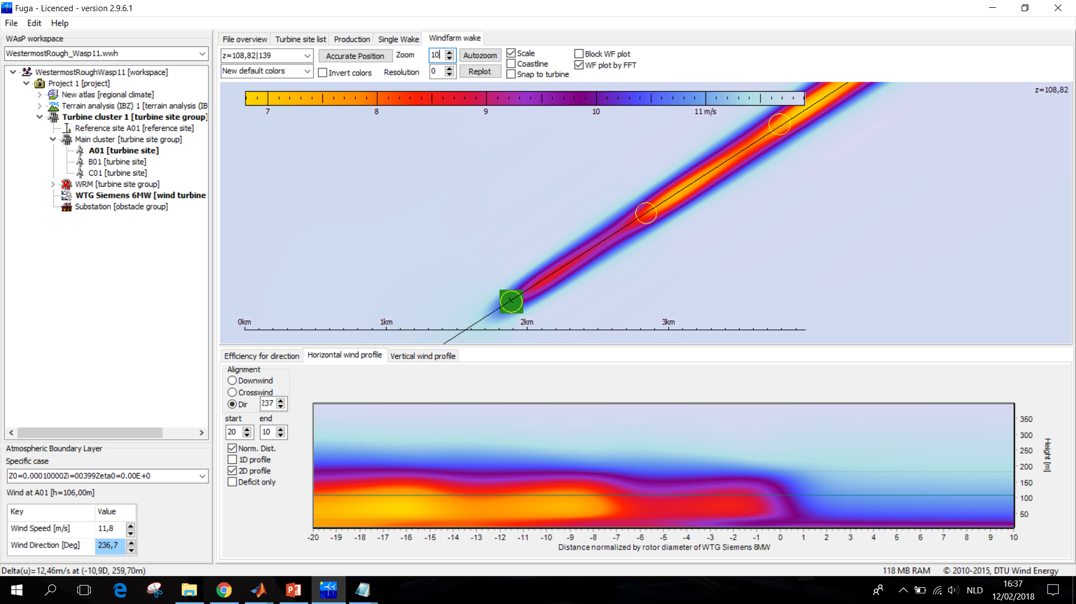
4. Fuga: Wind farm results
How to extract full field data?

Slide 21
5. Next steps
LES post-processing
Start validation
Comparing wind speed at hub height (averaged + at hub)
Comparing full wind profile

